Slide 1
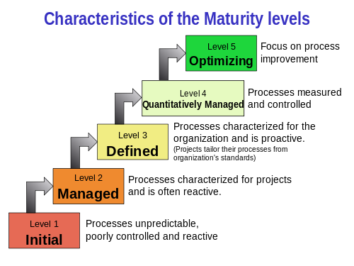

Slide 2
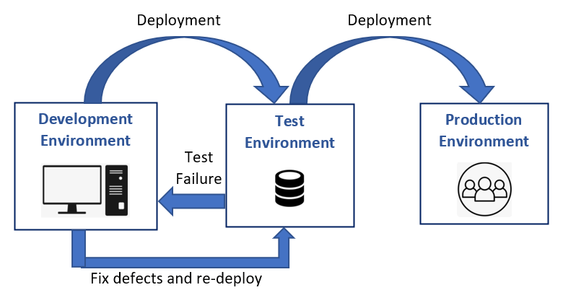

Slide 3
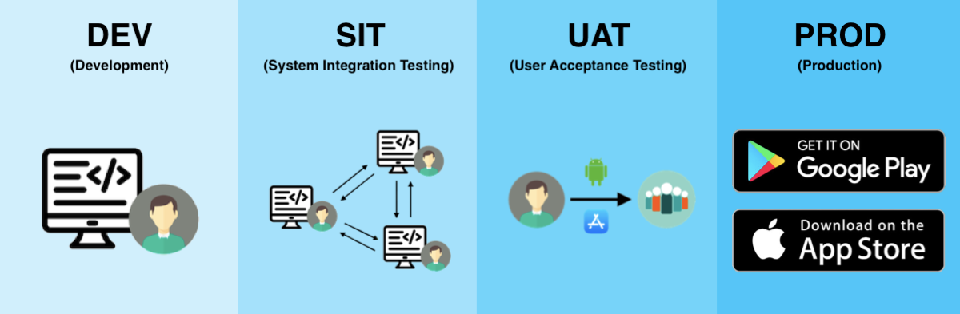
UAT Environment

Slide 4
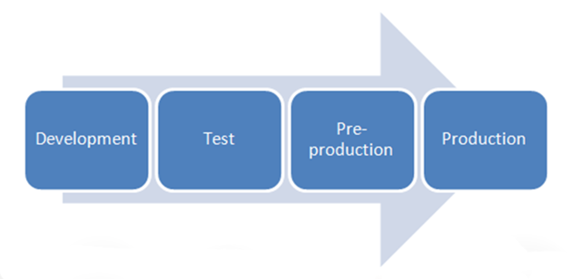
Pre-prod
Similar to prod, but it’s just internal to prod to make sure all process are in place.

Slide 5
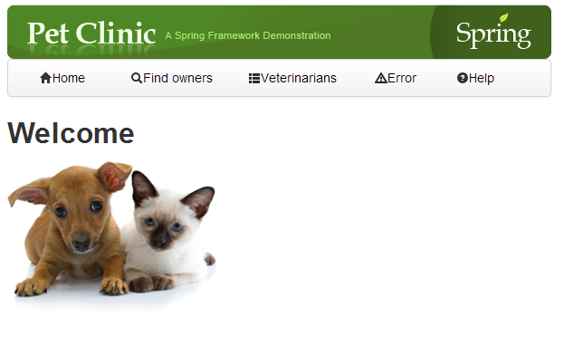
Spring pet clinic
Application that is designed for taking care of pets and plants.

Slide 6
Source code location and deployment steps
https://github.com/spring-projects/spring-petclinic
git clone https://github.com/spring-projects/spring-petclinic.git
cd spring-petclinic
./mvnw package
java -jar target/*.jar

Slide 7
Opensource
"Open source" refers to a type of software licensing that allows the source code to be freely used, modified, and distributed by anyone. The term "open source" originated from the open-source software movement, which promotes free access to the software's source code.

Slide 8
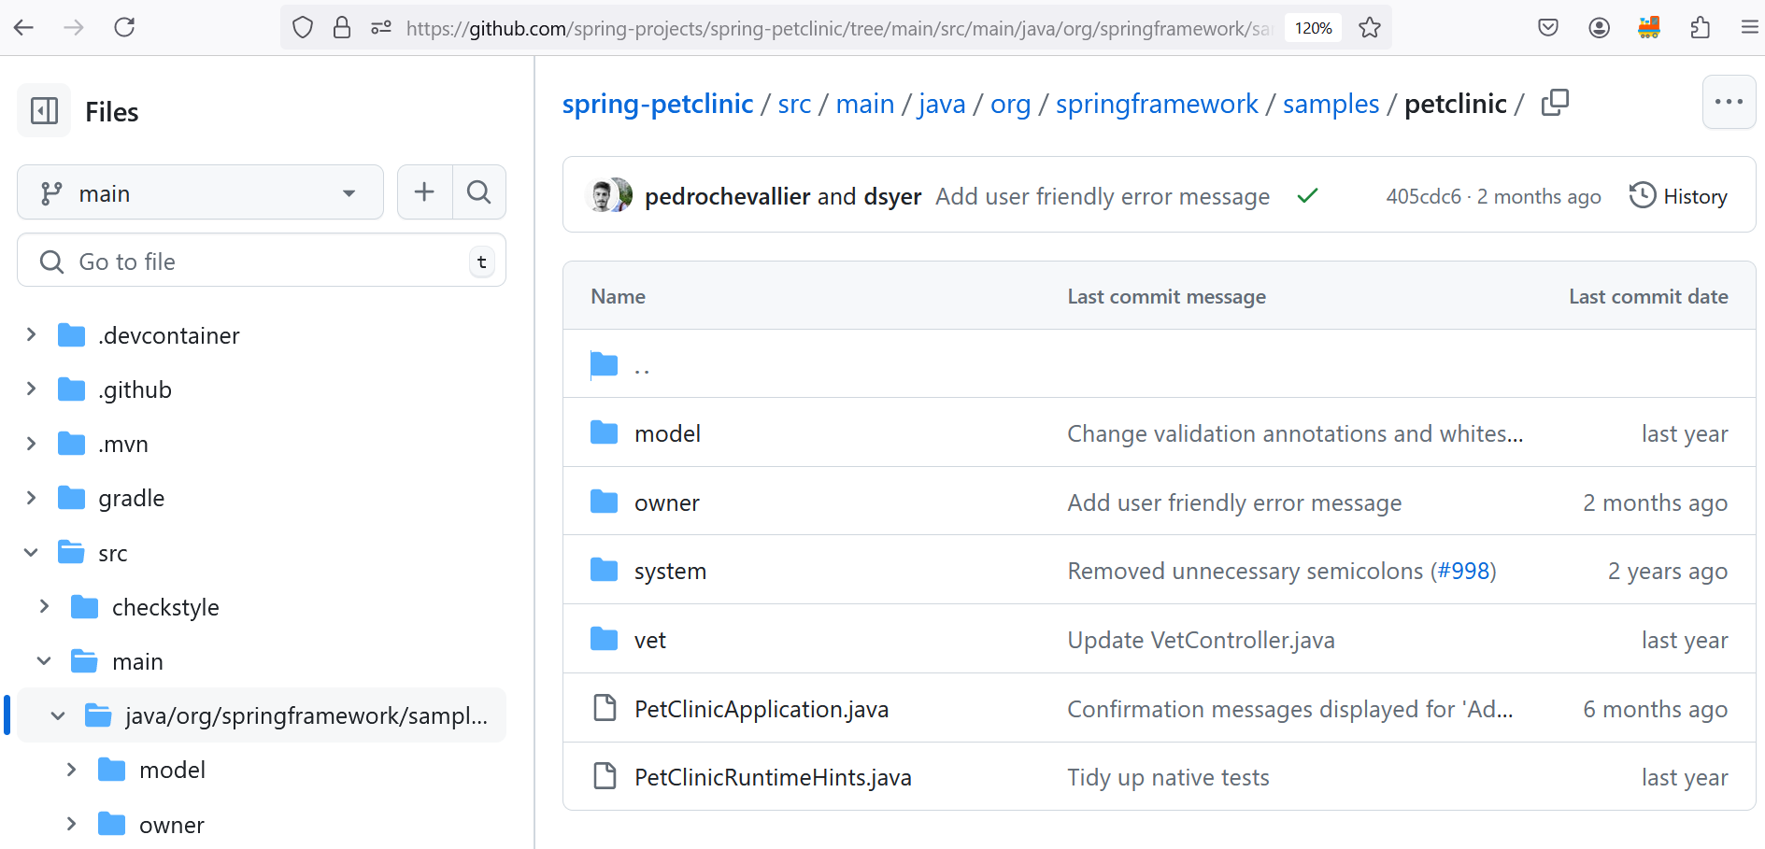

Slide 9
Task to be done
Task1: Compiling these java file and generating .classfile
Task2: combining all .class file generating .jar file
Jarfile: combination of .class file

Slide 10

Question?
Do I need to do them 5 times?

Slide 11
WORA:
WORA stands for "Write Once, Run Anywhere." This concept is primarily associated with programming languages like Java and refers to the ability to write code on one platform (or operating system) and run it on any other platform without modification
Platform Independence: Code written under the WORA paradigm is independent of the underlying hardware and operating system. This is achieved through the use of a virtual machine or an interpreter that can execute the same code across different environments.
Java Virtual Machine (JVM): In Java, WORA is enabled by the Java Virtual Machine (JVM), which abstracts the underlying hardware and operating system. The JVM interprets Java bytecode, which is the compiled version of Java source code, allowing it to run on any device that has a compatible JVM implementation.
Portability: WORA enhances the portability of applications, making it easier to deploy software across different systems without needing to rewrite or recompile code for each specific platform.
Development Efficiency: WORA allows developers to write their code once and be confident that it will work on any device or platform that supports the necessary runtime environment, saving time and effort in development and testing.

Slide 12
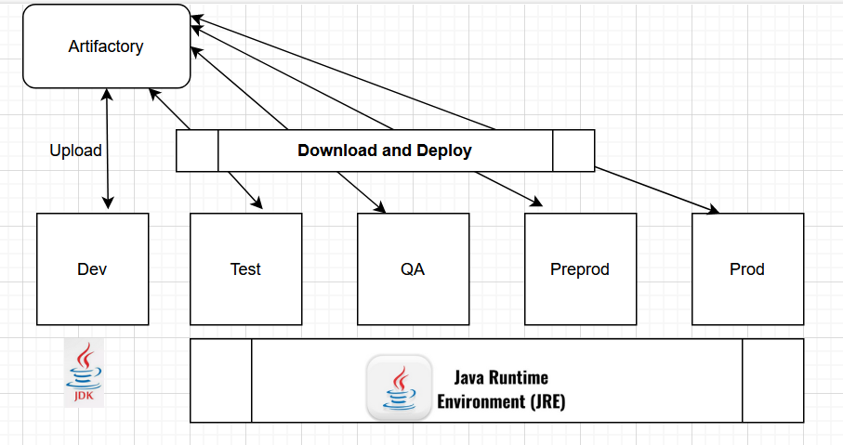
Planning summary

Slide 13
Maven
Instead of JDK we can use maven which is a
build automation tool used primarily for Java projects. Maven can also be used to build and manage projects written in C#, Ruby, Scala, and other languages. The Maven project is hosted by The Apache Software Foundation, where it was formerly part of the Jakarta Project.

Slide 14
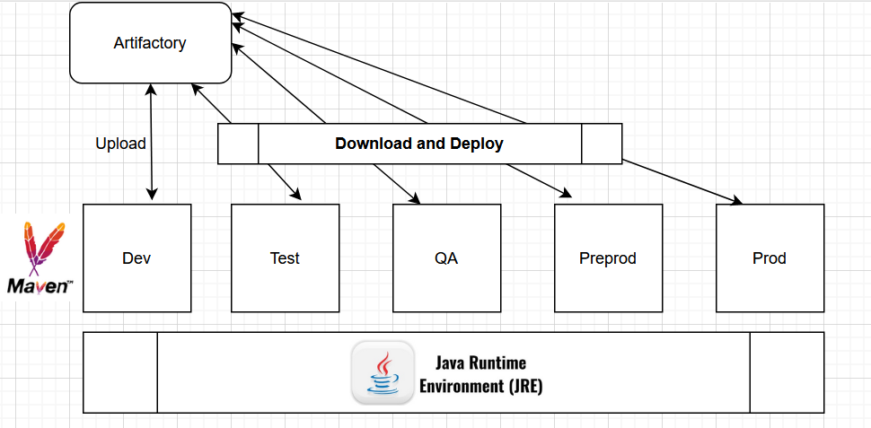
Maven to make process uniform

Slide 15
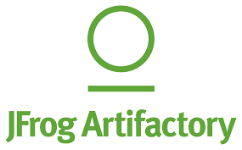
Lets create artifactory

Slide 16
Integrate maven with artifactory
Understand pom.xml
Understand security file

